Slide 1
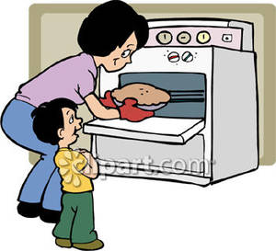
Basic 2 – Unit 5b - Listening
Let´s cook!!!

Slide 2

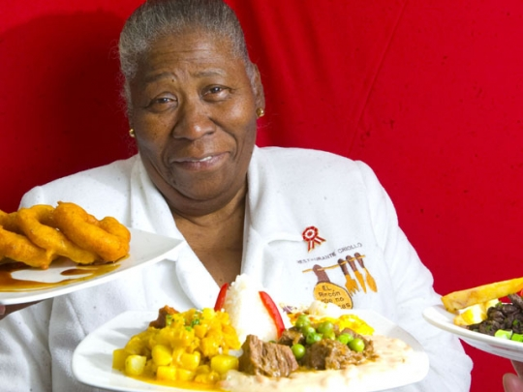
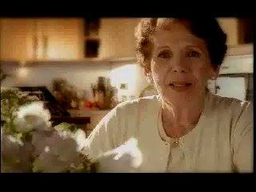

Slide 3
PASTA WITH TOMATO SAUCE
LET¨S COOK!!

Slide 4
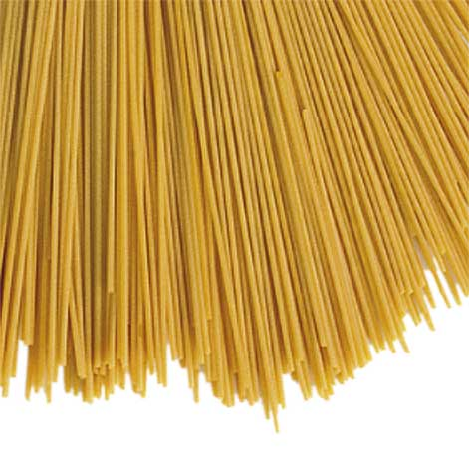
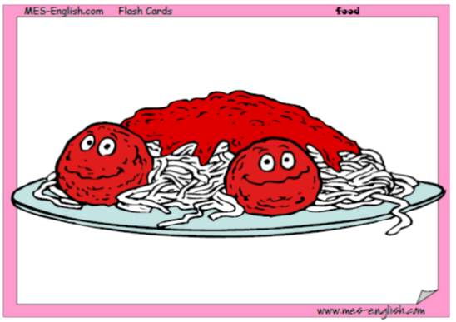
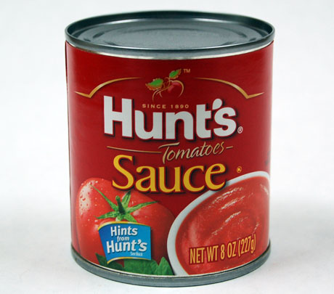
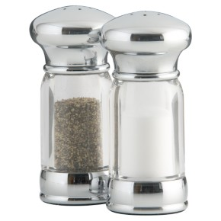
ingrdients
Pasta
A can of tomato sauce
Salt & Pepper

Slide 5
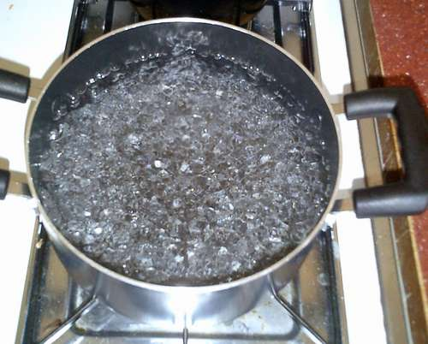
Boil water

Slide 6
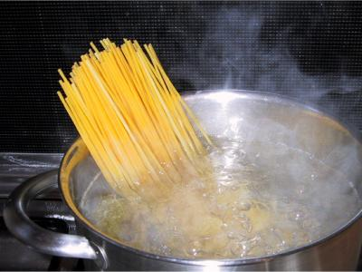
Boil pasta

Slide 7
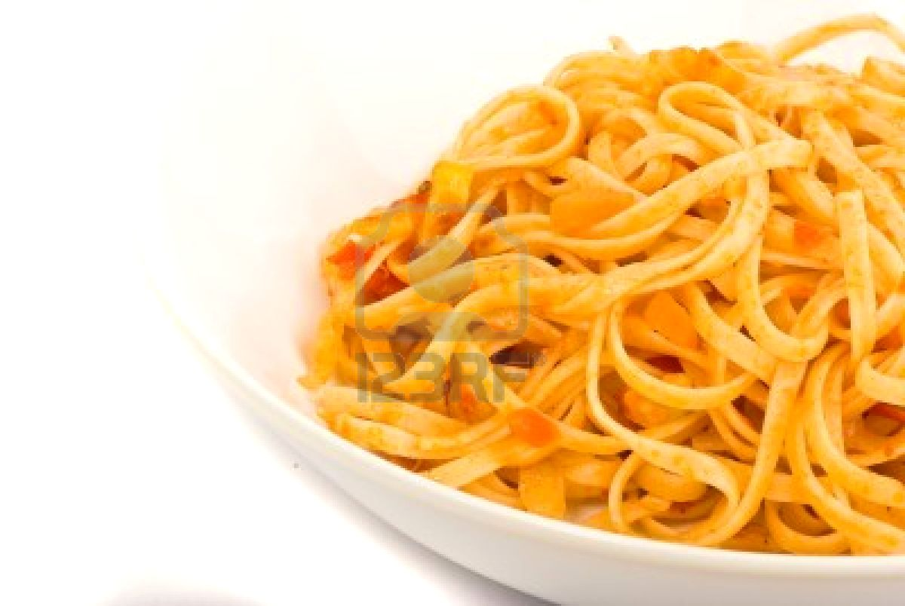
Serve pasta on plate

Slide 8
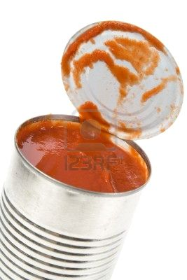
Open can of tomato sauce

Slide 9
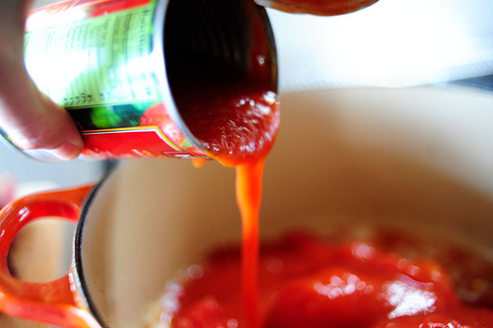
Pour tomato sauce

Slide 10
Serve pasta

Slide 11
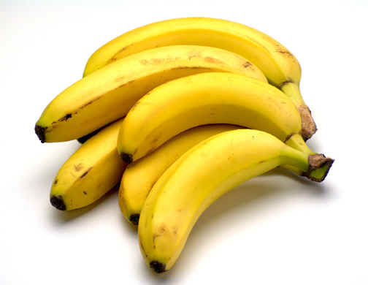

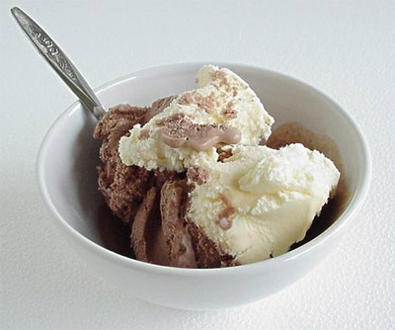
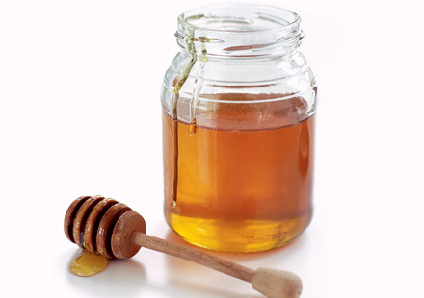

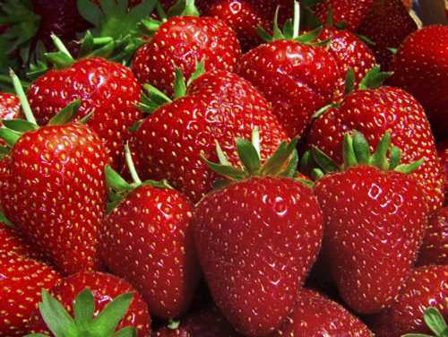

bananas
Ice cubes
Ice cream
Honey
oranges
strawberries
Milk

Slide 12

Juniors 6 – module 6 - Unit 30
Let´s make a smoothie!!!

Slide 13
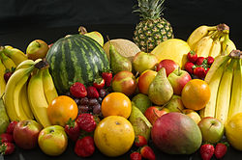
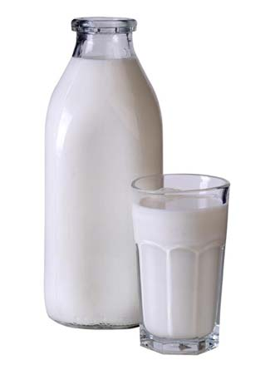
ingrdients
Fruit
Smothies
Milk
Honey

Slide 14
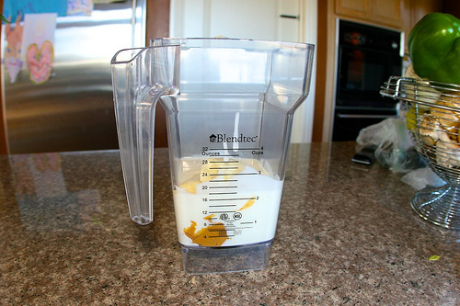
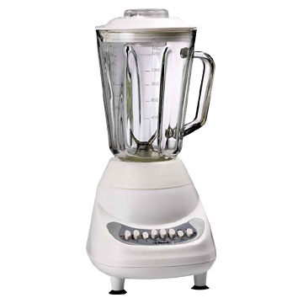

Eggs
Put the ingredients in the blender
Milk
Blender
Ice
Honey

Slide 15
French Fries
LET¨S COOK!!

Slide 16
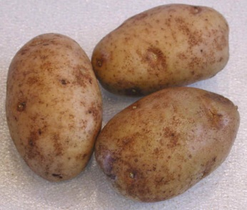
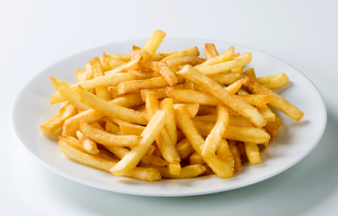

ingrdients
3 Potatoes
French fries
Some Oil
Salt & Pepper

Slide 17
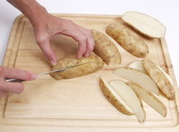
Cut potatoes

Slide 18
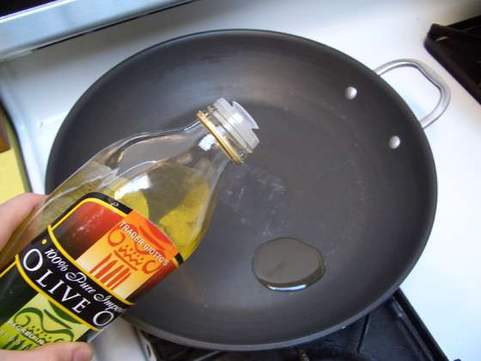
Pour oil

Slide 19
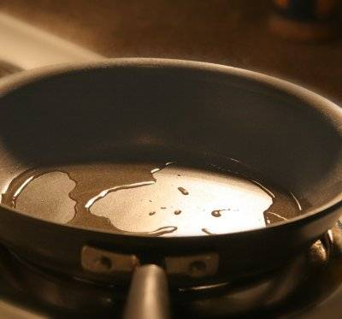
Heat oil

Slide 20
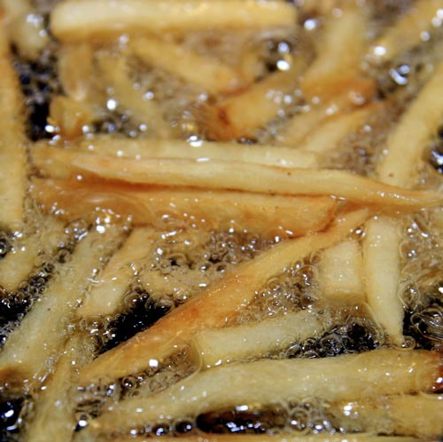
Fry the French fries

Slide 21
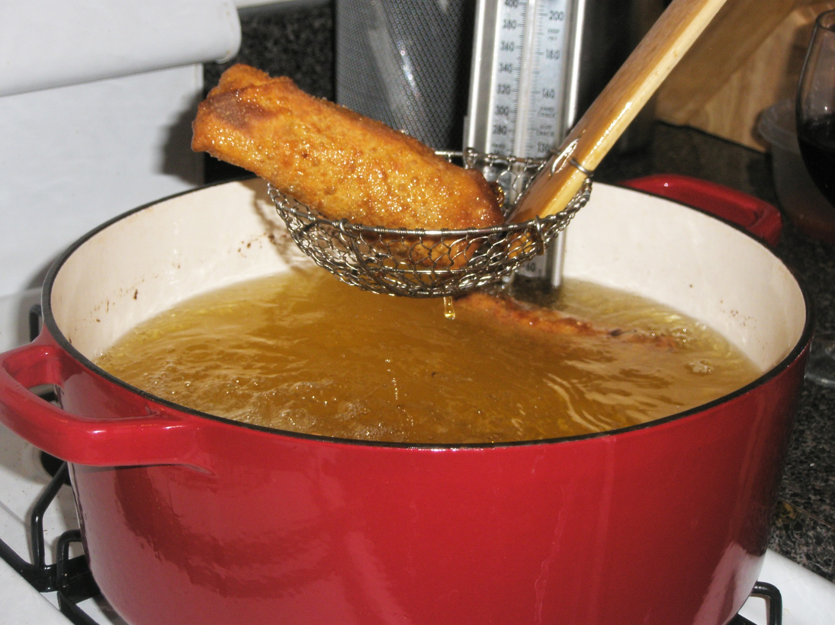
Fry until golden brown

Slide 22
Serve French fries

Slide 23
pancakes
LET¨S COOK!!

Slide 24

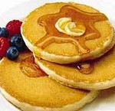
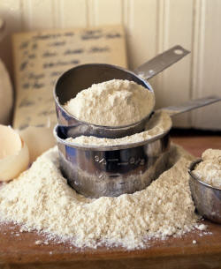
ingrdients
4 Eggs
Pancakes
A cup of Milk
Some Flour

Slide 25

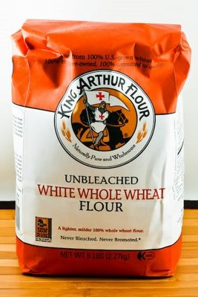
Eggs
Put the ingredients in the blender
Milk
Blender
Flour

Slide 26
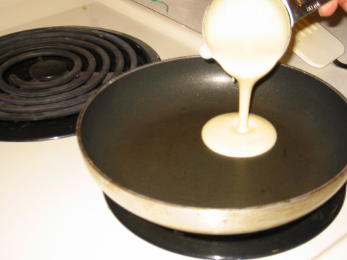
Pour the mixture

Slide 27
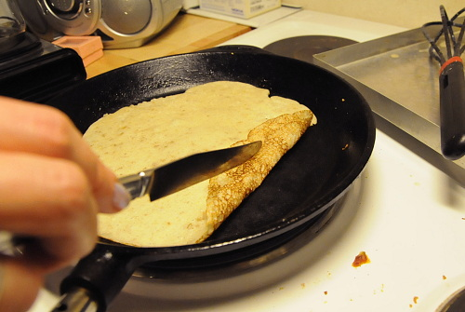
Cook until golden brown

Slide 28
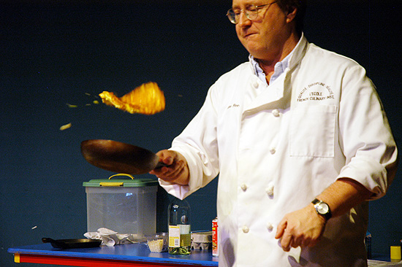
Flip the pancake

Slide 29
Serve with maple syrup
(Maple syrup)

Slide 30
Cake
LET¨S COOK!!

Slide 31
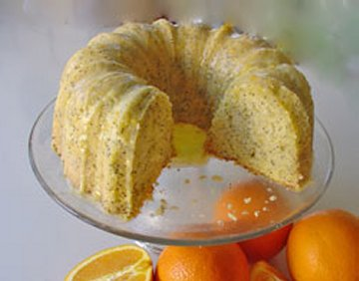
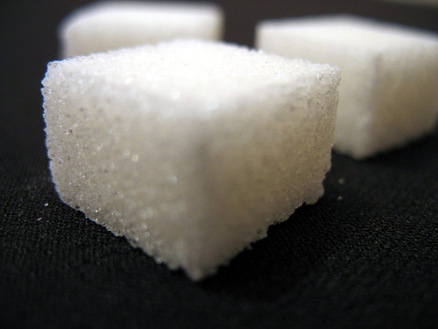
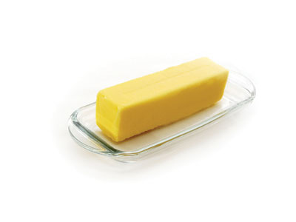
ingrdients
Cake
Eggs
A cup of Milk
A cup of Sugar
Some Butter
Some Flour

Slide 32
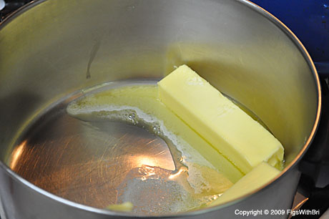
Melt the butter

Slide 33
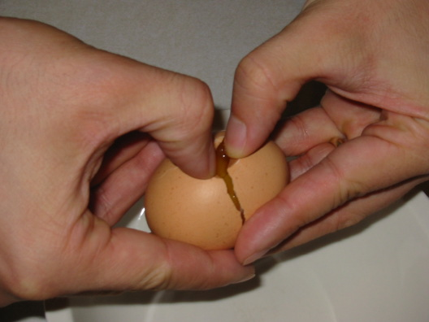
Break the eggs

Slide 34
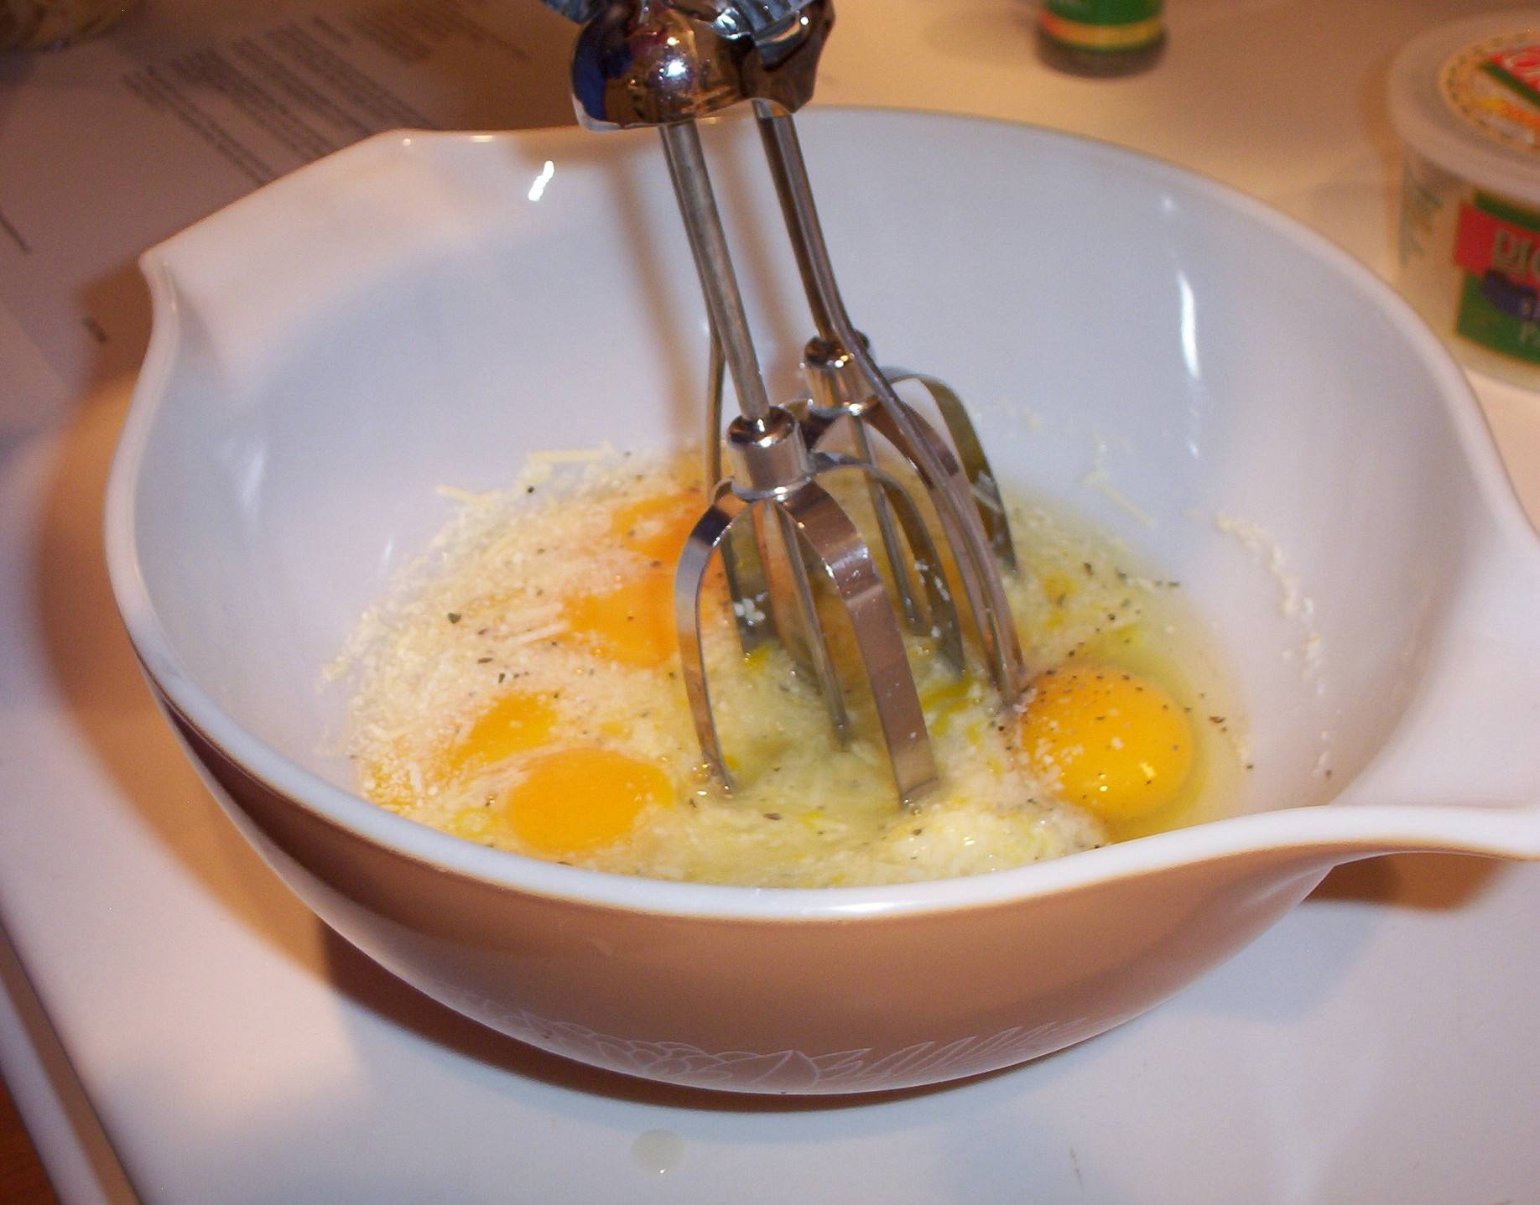
Beat the eggs

Slide 35
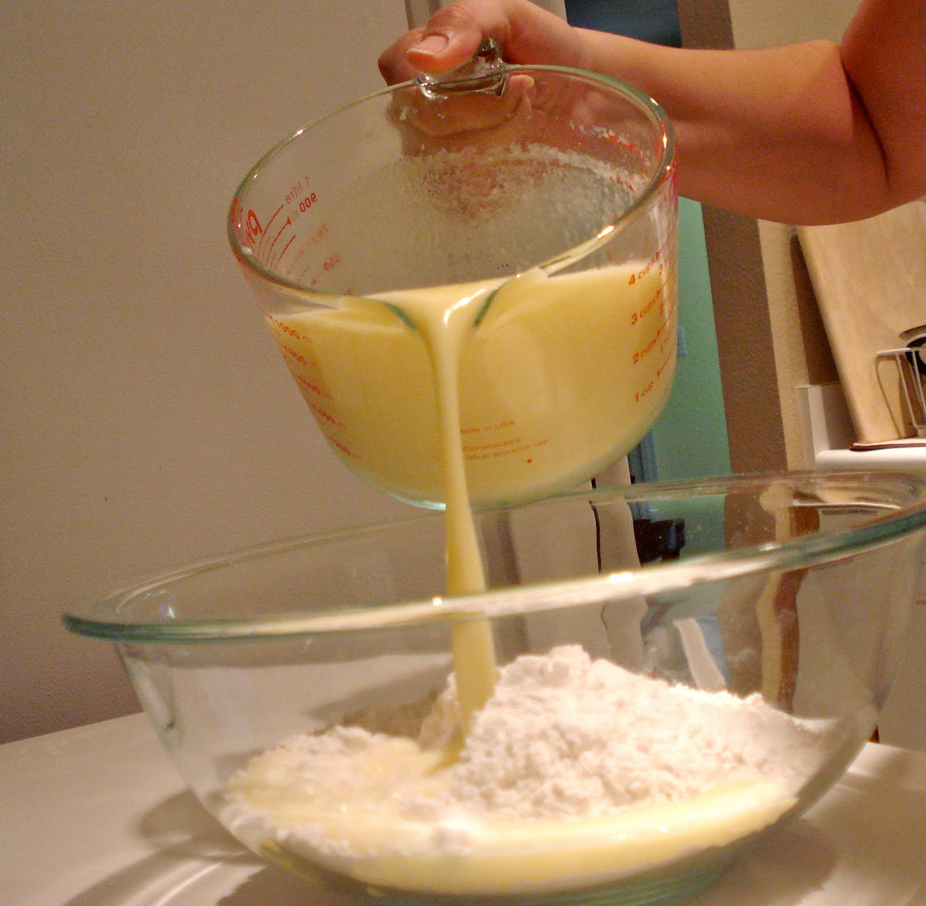
Pour the mixture on the flour

Slide 36
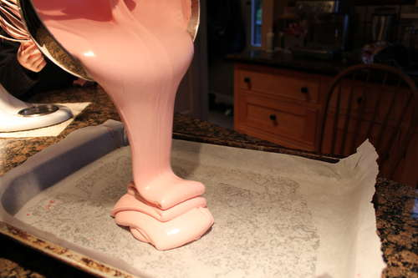
Pour the mixture on the pan

Slide 37
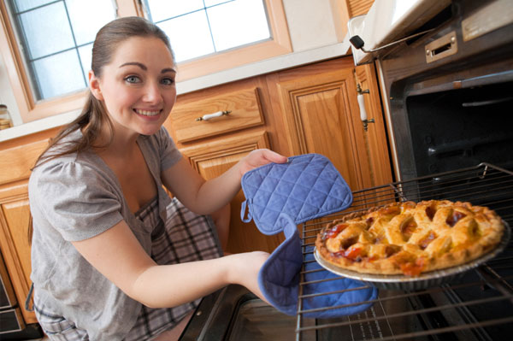
Bake the pie

Slide 38
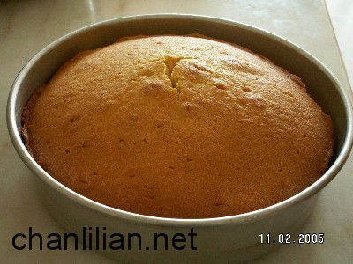
Bake the cake

Slide 39
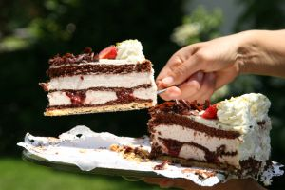
Serve the cake

